Slide 1
Evolution : From 2G to 3G
Primary Requirements of a 3G Network
Fully specified and world-widely valid, Major interfaces should be standardized and open.
Supports multimedia and all of its components.
Wideband radio access.
Services must be independent from radio access technology and is not limited by the network infrastructure.

Slide 2
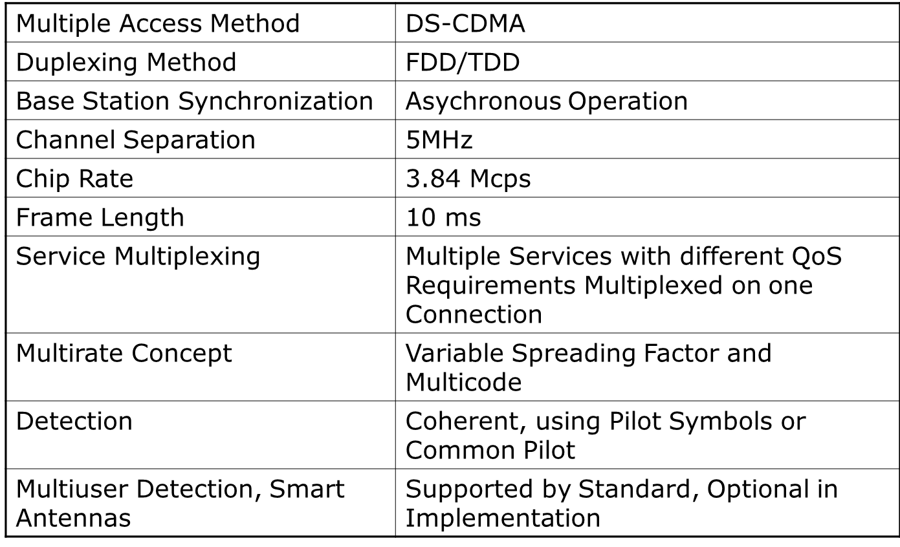
Standardization of WCDMA / UMTS WCDMA Air Interface, Main Parameters

Slide 3
UMTS System Architecture
Uu
Iu
Node B
MSC/ VLR
GMSC
RNC
Node B
USIM
Cu
Iur
HLR
Iub
External Networks
ME
Node B
RNC
SGSN
GGSN
Node B
UE
UTRAN
CN

Slide 4
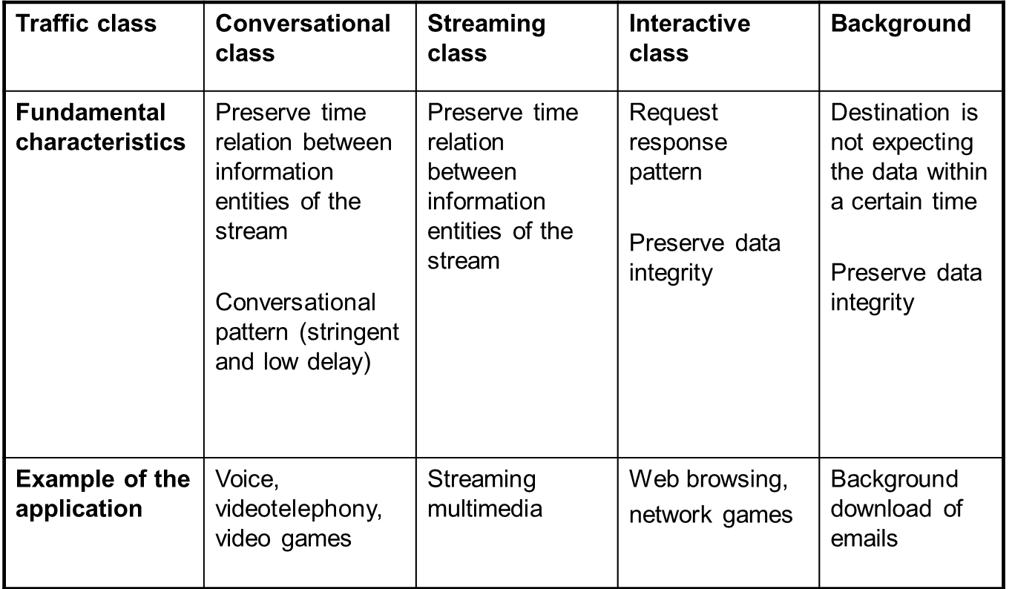
UMTS QoS Classes

Slide 5
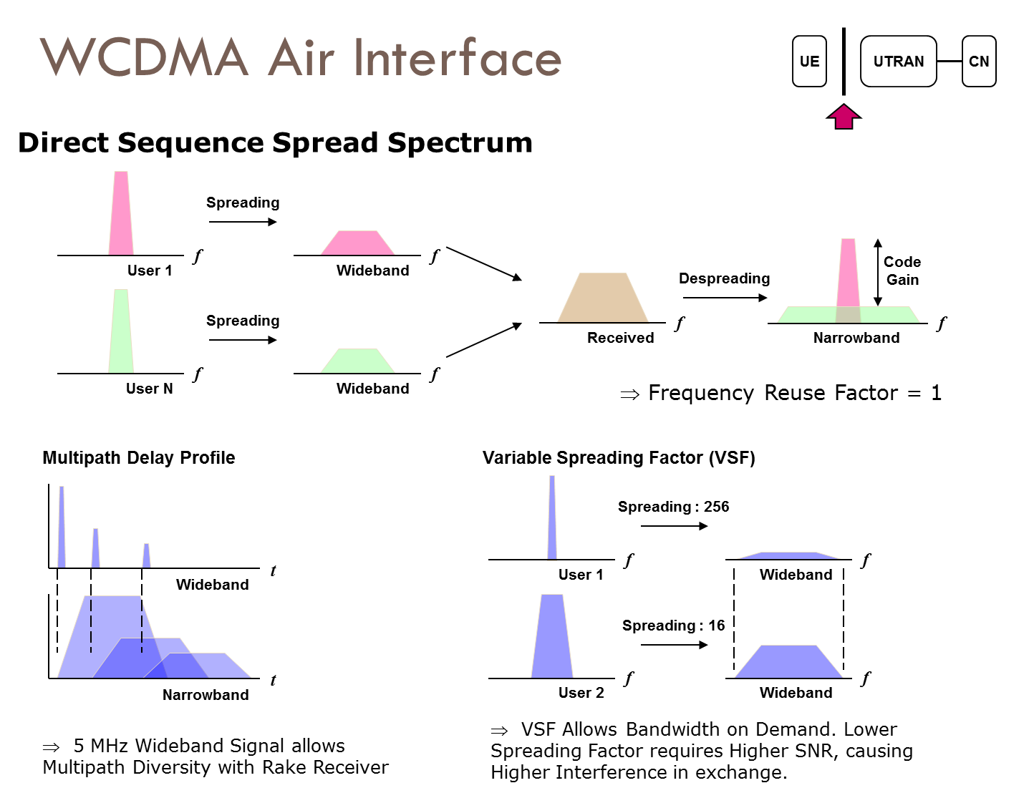

Slide 6
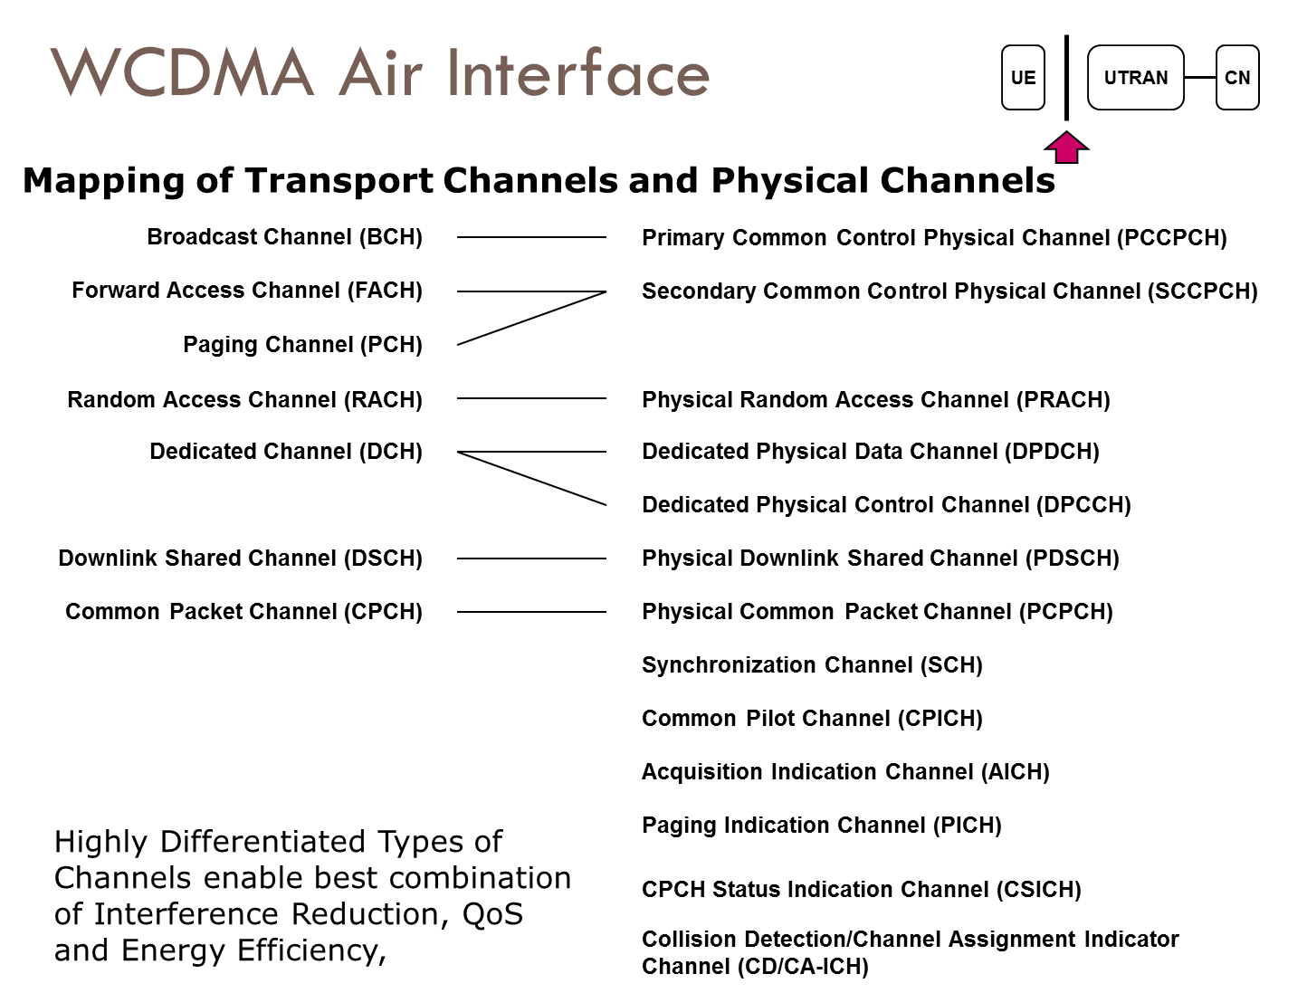

Slide 7
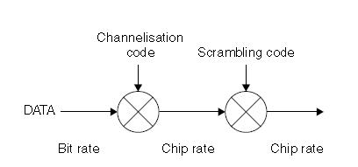
Codes in WCDMA
Channelization Codes (=short code)
Used for
channel separation from the single source in downlink
separation of data and control channels from each other in the uplink
Same channelization codes in every cell / mobiles and therefore the additional scrambling code is needed
Scrambling codes (=long code)
Very long (38400 chips = 10 ms =1 radio frame), many codes available
Does not spread the signal
Uplink: to separate different mobiles
Downlink: to separate different cells
The correlation between two codes (two mobiles/Node Bs) is low
Not fully orthogonal

Slide 8
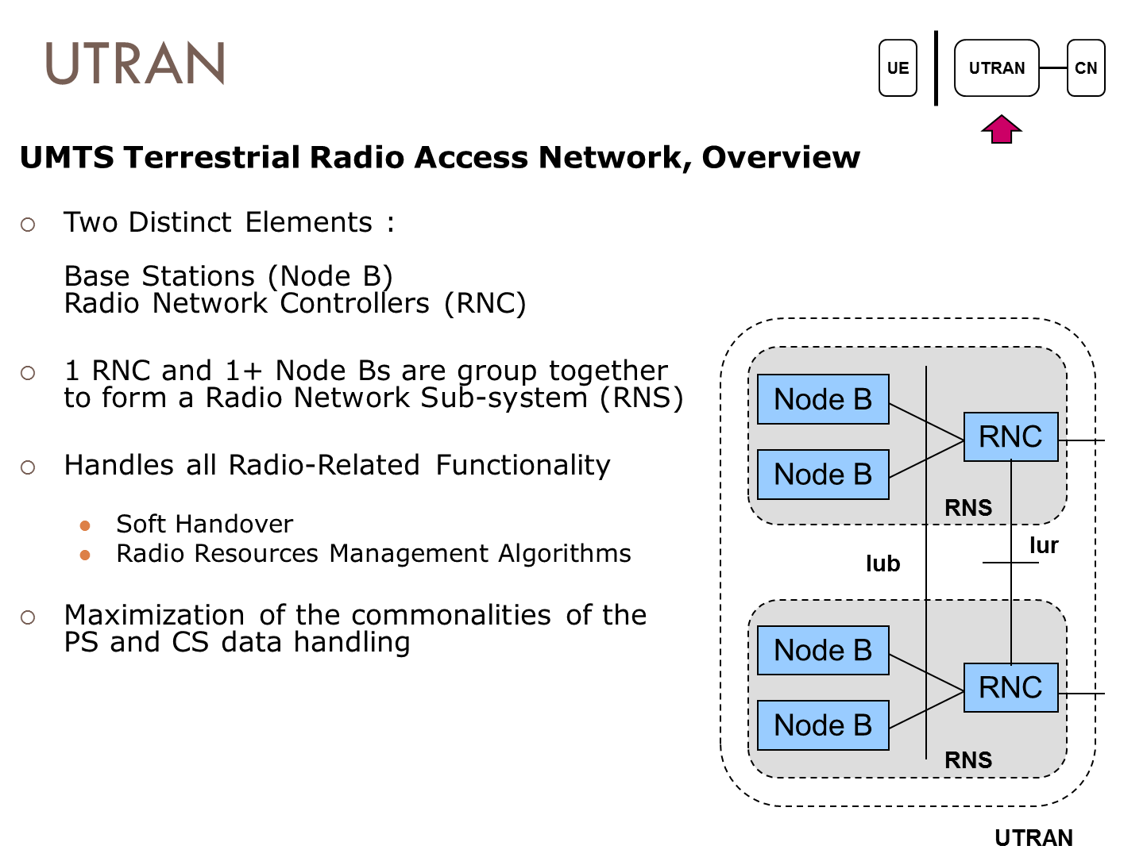

Slide 9
RNC Functions
Radio resource management
Serving RNS relocation
Frame synchronization
Macro diversity combining
Intra-UTRAN handoff
Splitting of the Iub data streams
Outer loop power control
RLC sublayers function execution

Slide 10
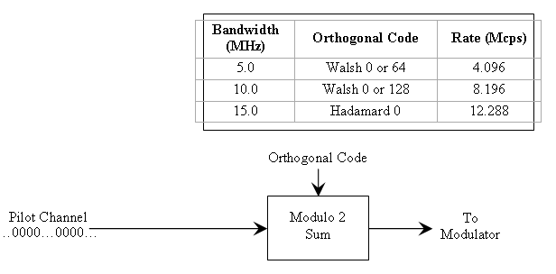
Forward W-CDMA Pilot Channel Processing

Slide 11
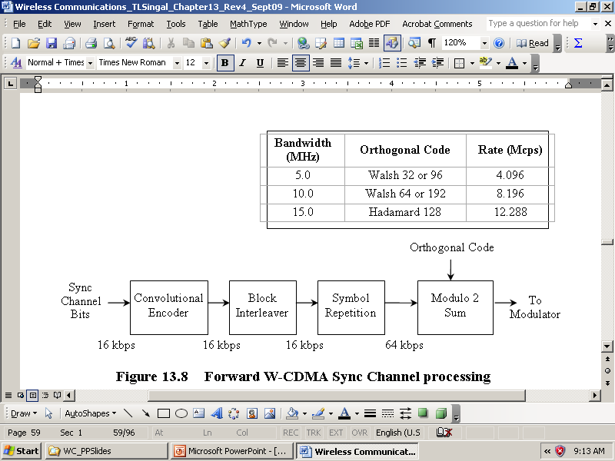
Forward W-CDMA Sync Channel Processing

Slide 12
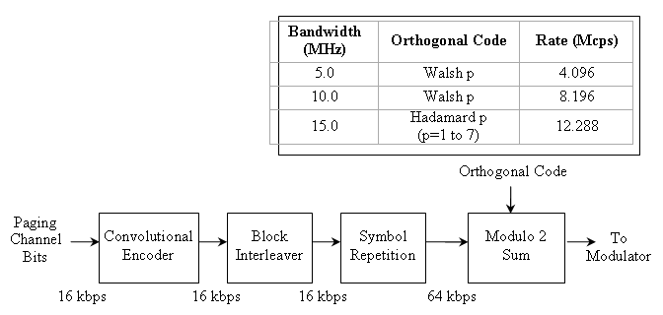
Forward W-CDMA Paging Channel Processing

Slide 13
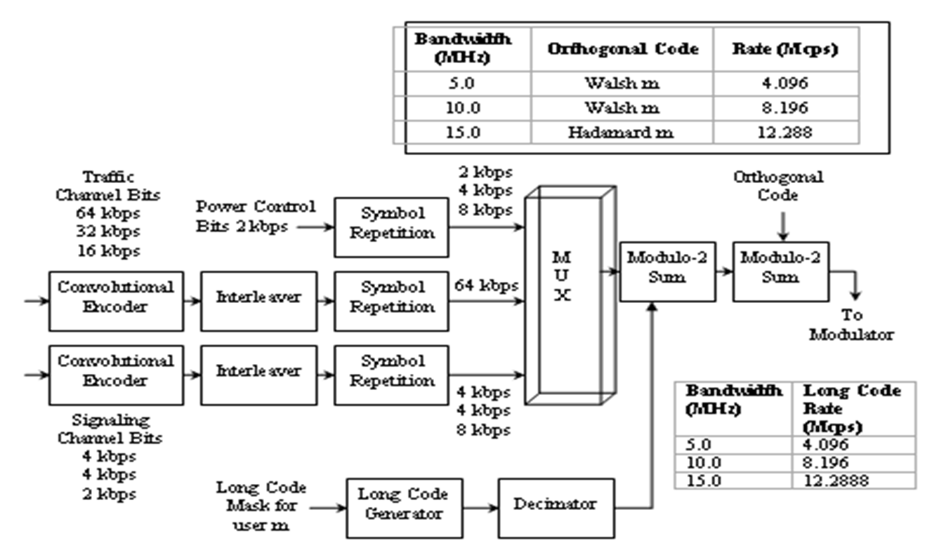
Forward W-CDMA Traffic Channel

Slide 14
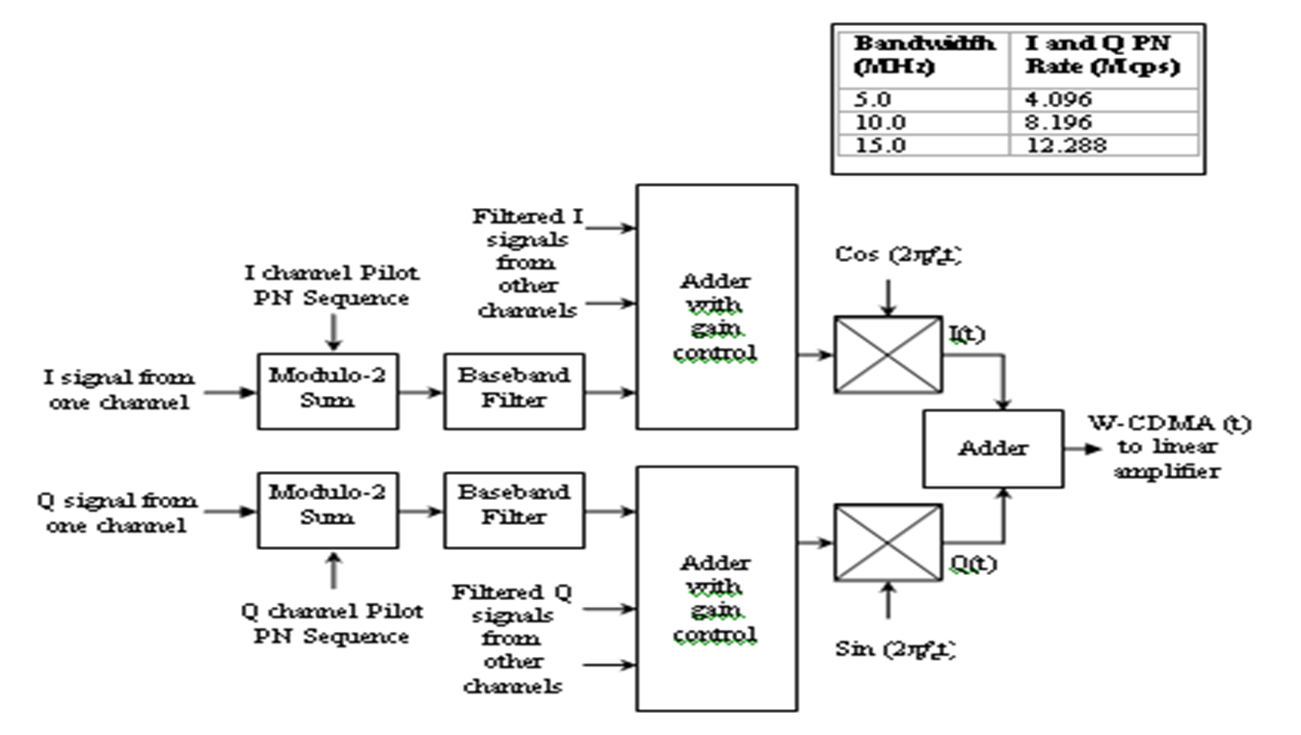
Forward W-CDMA Channel Modulator

Slide 15
TD-SCDMA Technology
Time Division – Synchronous Code Division Multiple Access (TD-SCDMA) : one of IMT-2000 3G cellular standards
Uses time division duplexing (TDD) scheme
Accommodate asymmetric traffic data rate
Based on 1.6 MHz spread spectrum technology
Uses smart antennas based on switched-beam scheme

Slide 16
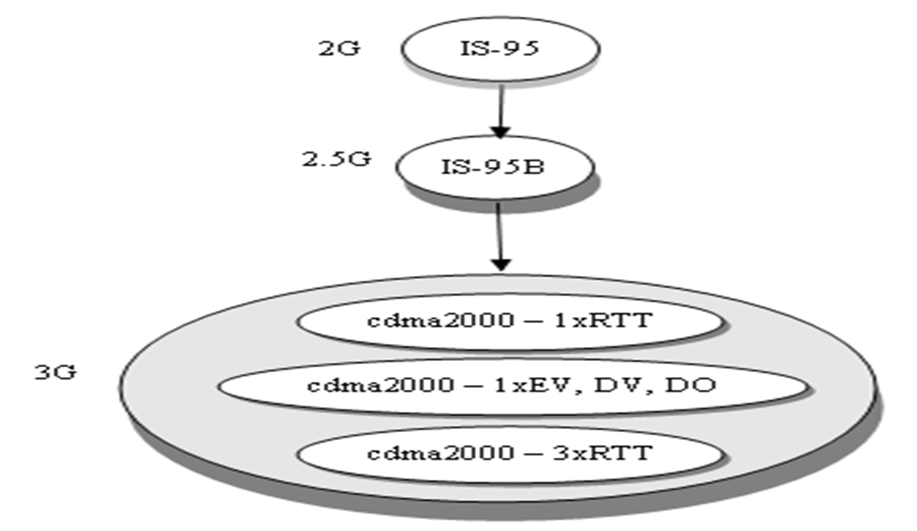
3G CDMA Evolution Path

Slide 17
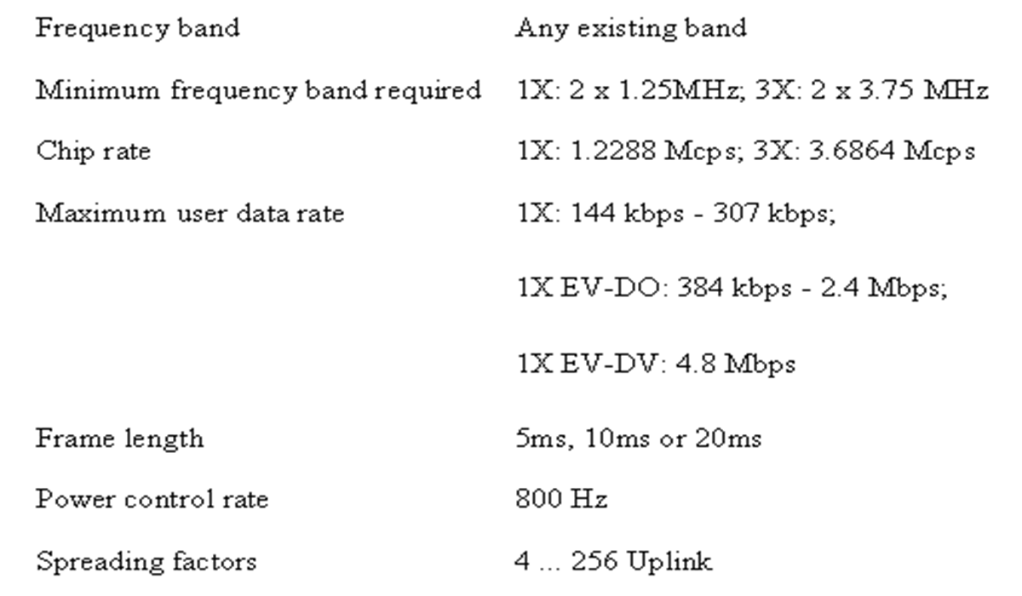
Cdma2000 Technical Specifications

Slide 18
Key Features of Cdma2000
Leading performance in terms of data-speeds, voice capacity and latencies
Efficient use of spectrum
Support for advanced mobile services
Compatible with IP
Broadest selection of mobile devices
Seamless evolution path
Flexibility

Slide 19
Advantages of Cdma2000
Superior voice clarity
High-speed broadband data connectivity
Low end-to-end latency
Increased voice and data throughput capacity
Differentiated value-added services
Robust link budget for extended coverage
Improved security and privacy

Slide 20
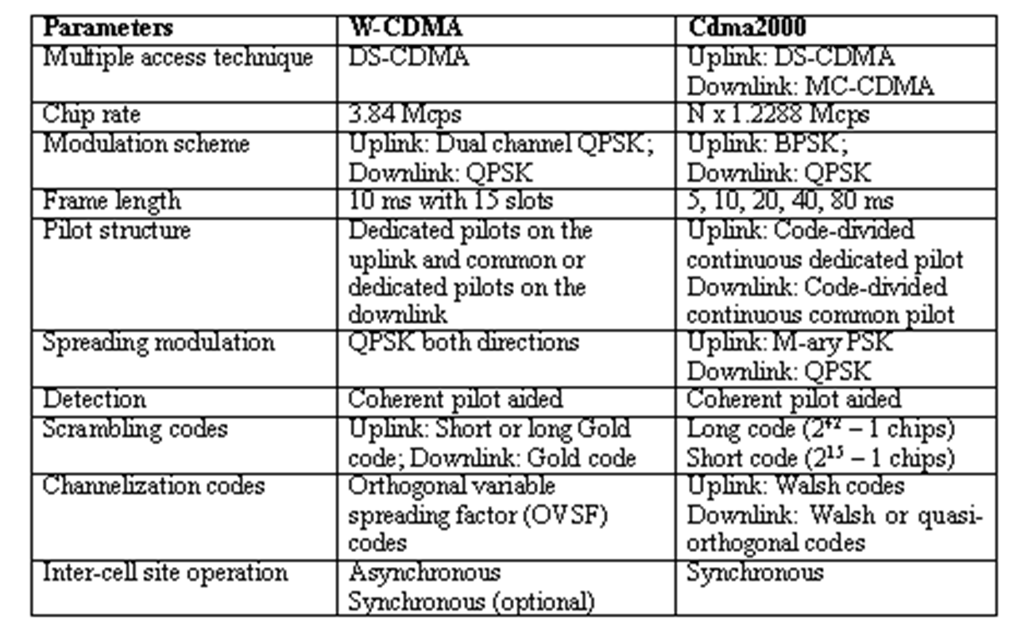
WCDMA versus Cdma2000

Slide 21
Marching Towards 4G …..
Third Generation Cellular Networks (3G)
Digital systems based on TDMA (GSM) and CDMA with data rate capability up to 2 Mbps (e.g. WCDMA/UMTS, cdma2000, UWC-136)
Fourth Generation Cellular Networks (4G)
Digital systems based on OFDMA and MC-CDMA with higher data rate capability for advanced multimedia applications.

Slide 22
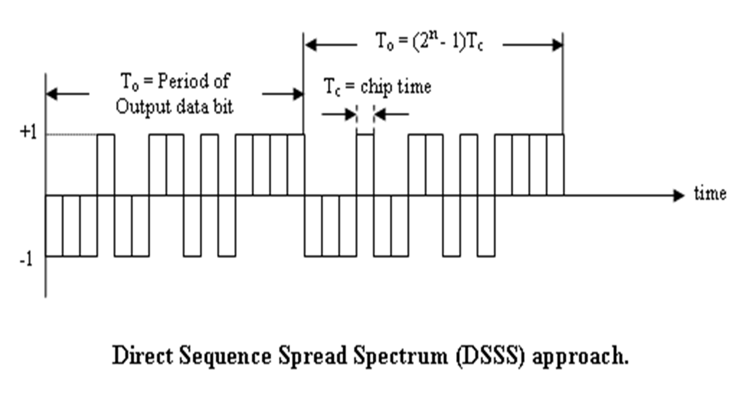
Concept of Spread Spectrum

Slide 23
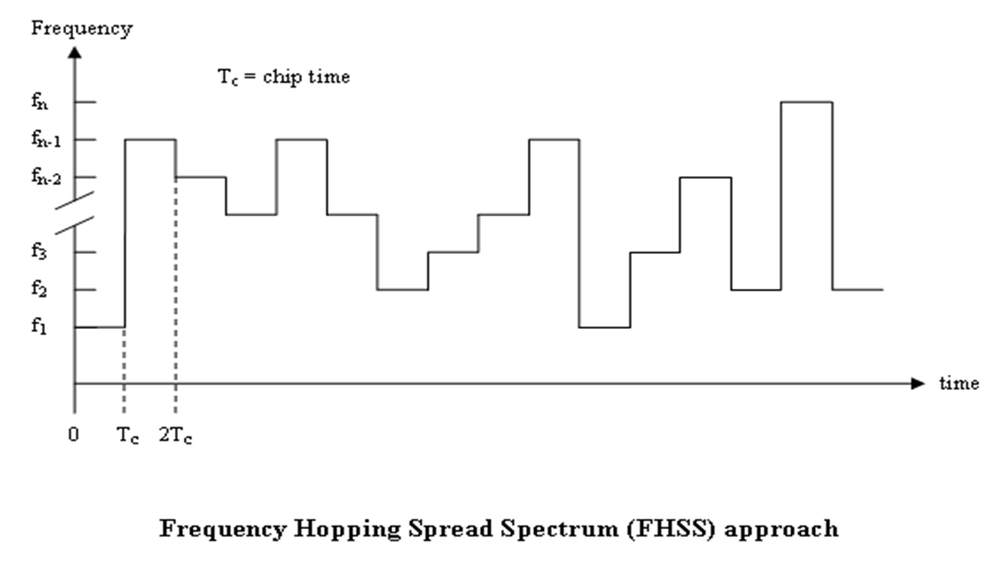
Concept of Spread Spectrum

Slide 24
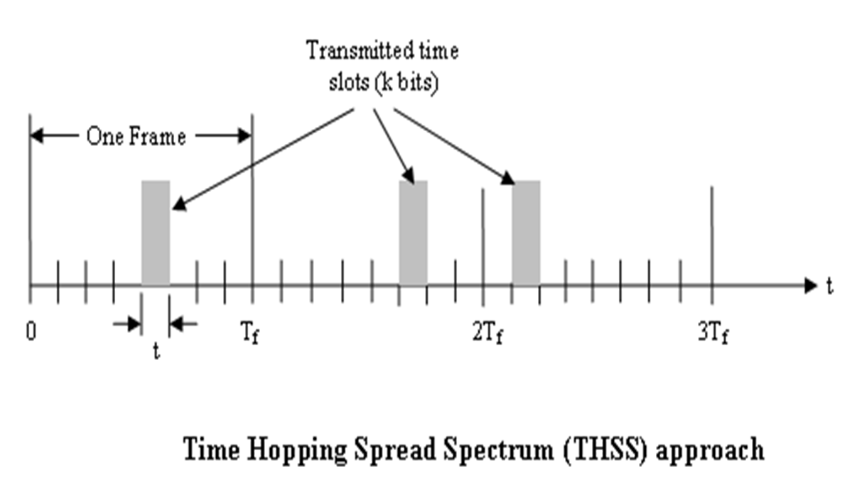
Concept of Spread Spectrum

Slide 25
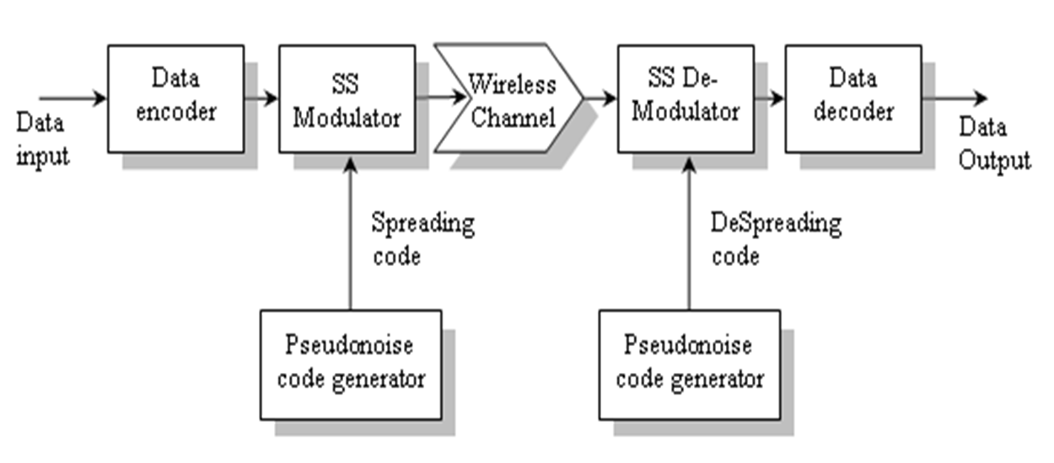
General Model of Spread Spectrum System

Slide 26
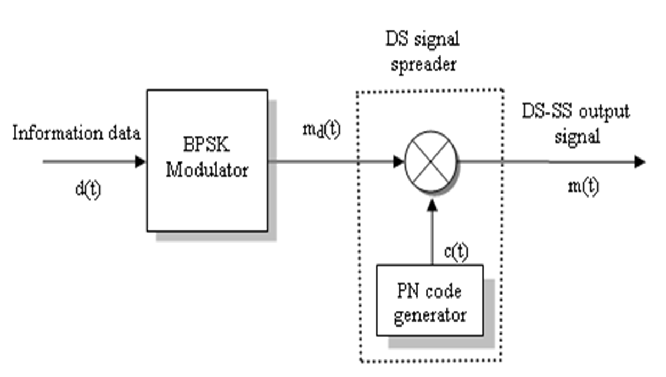
A DSSS Transmitter System

Slide 27
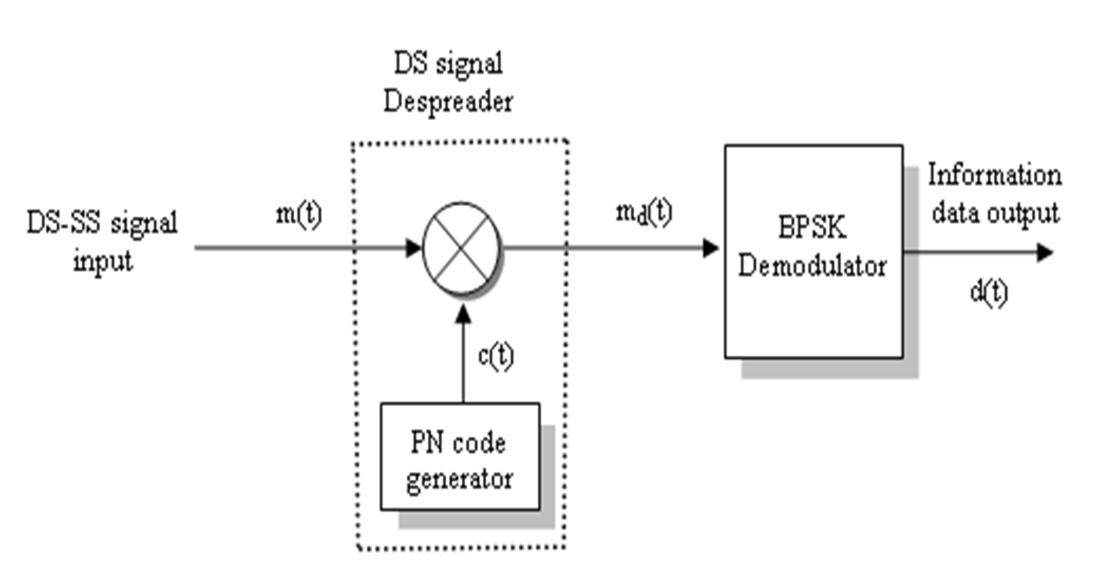
A DSSS Receiver System

Slide 28
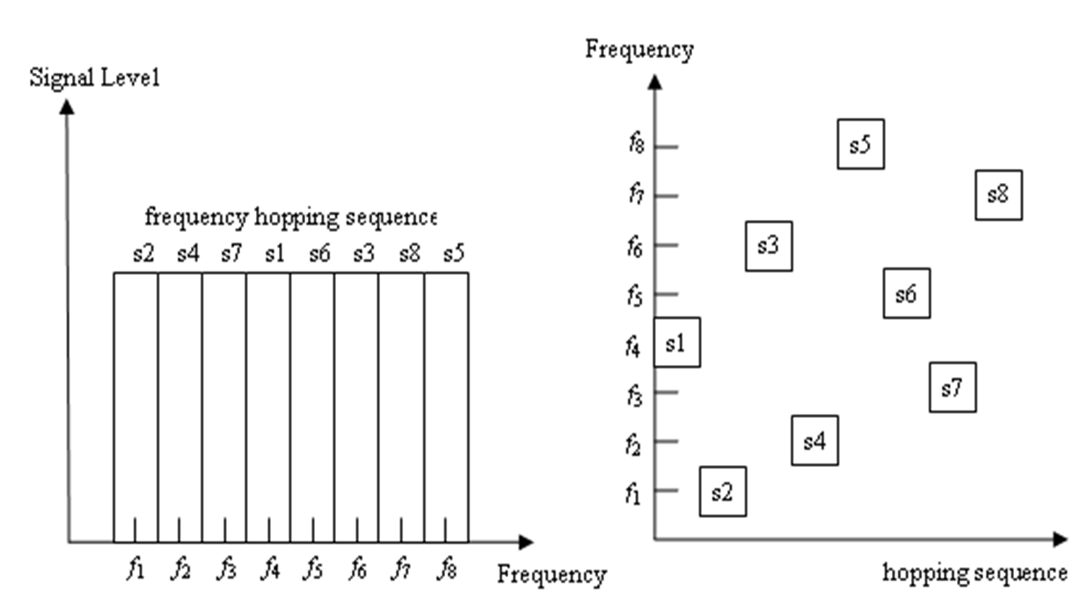
Concept of Frequency Hopping

Slide 29
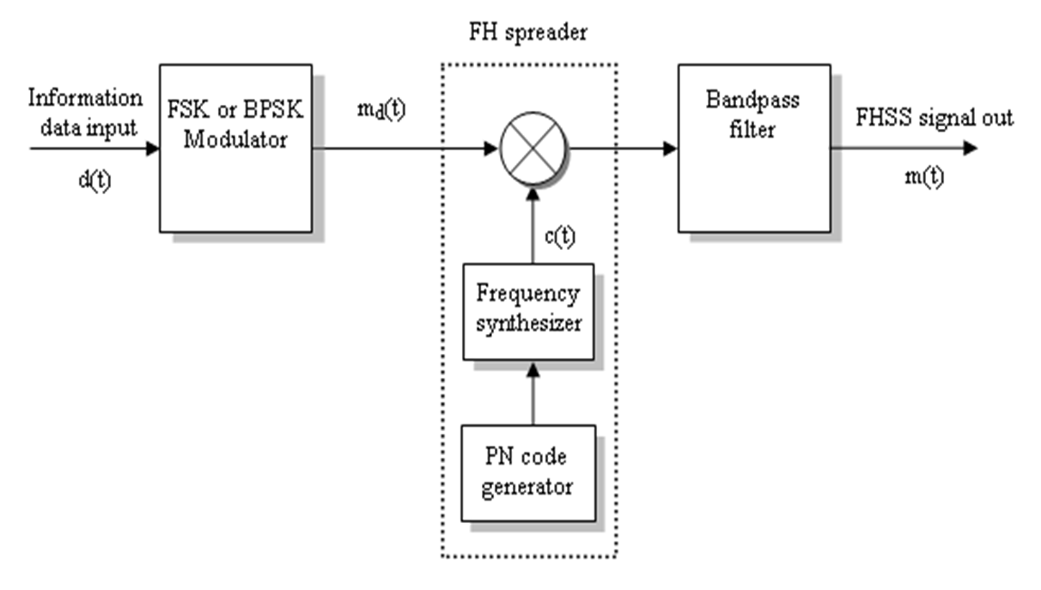
A FHSS Transmitter System

Slide 30
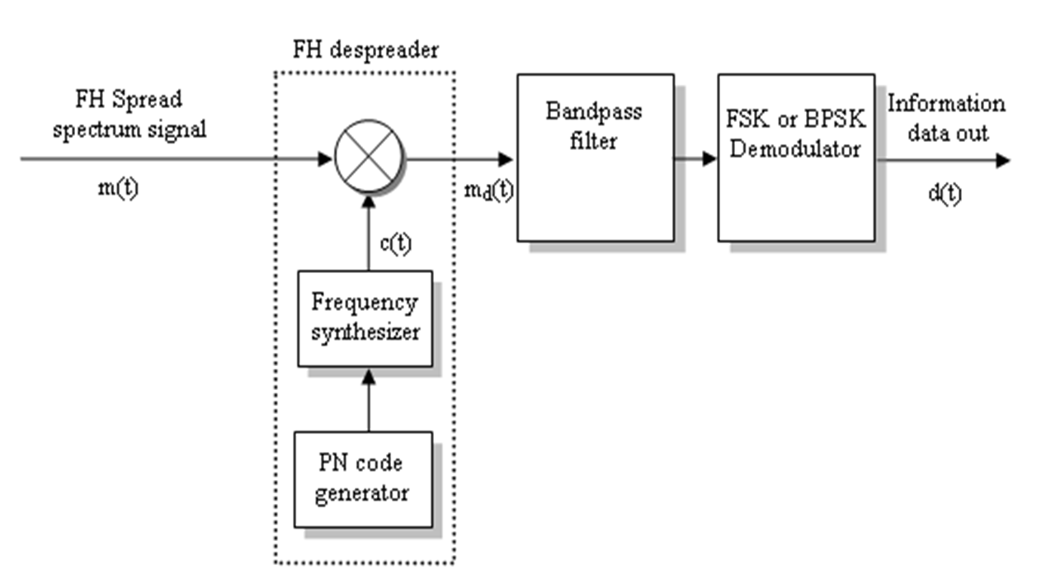
A FHSS Receiver System

Slide 31
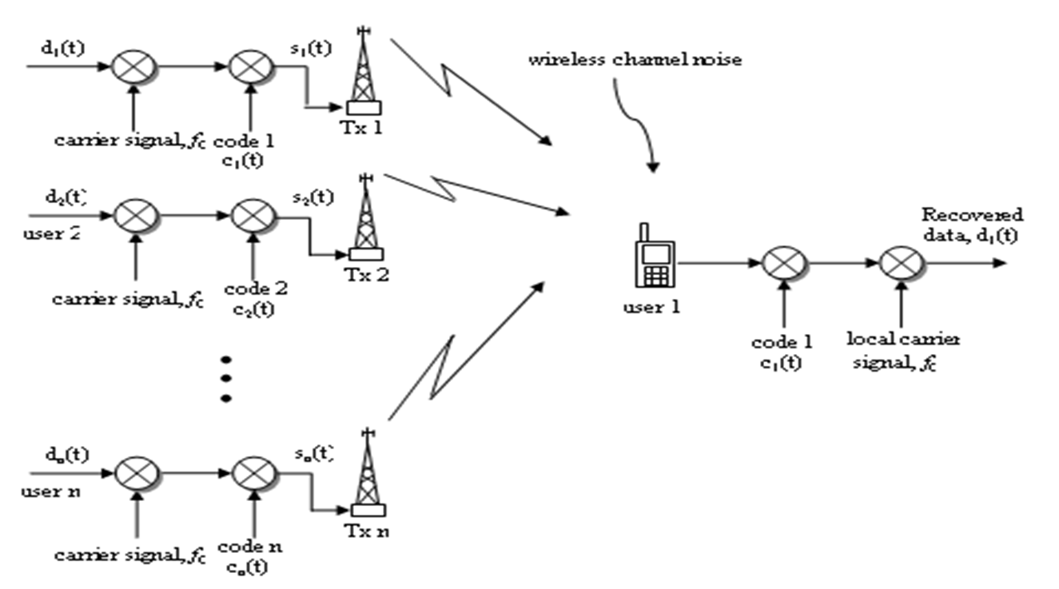
CDMA in a DSSS Environment

Slide 32
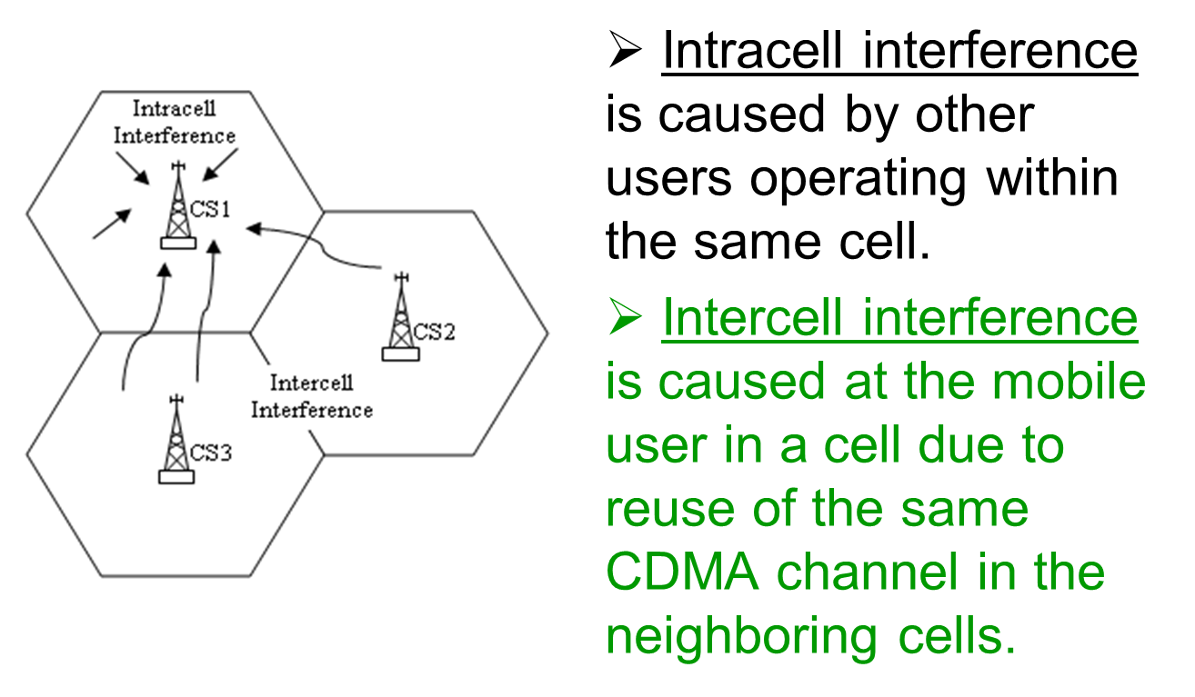
Multiple-Access Interference

Slide 33
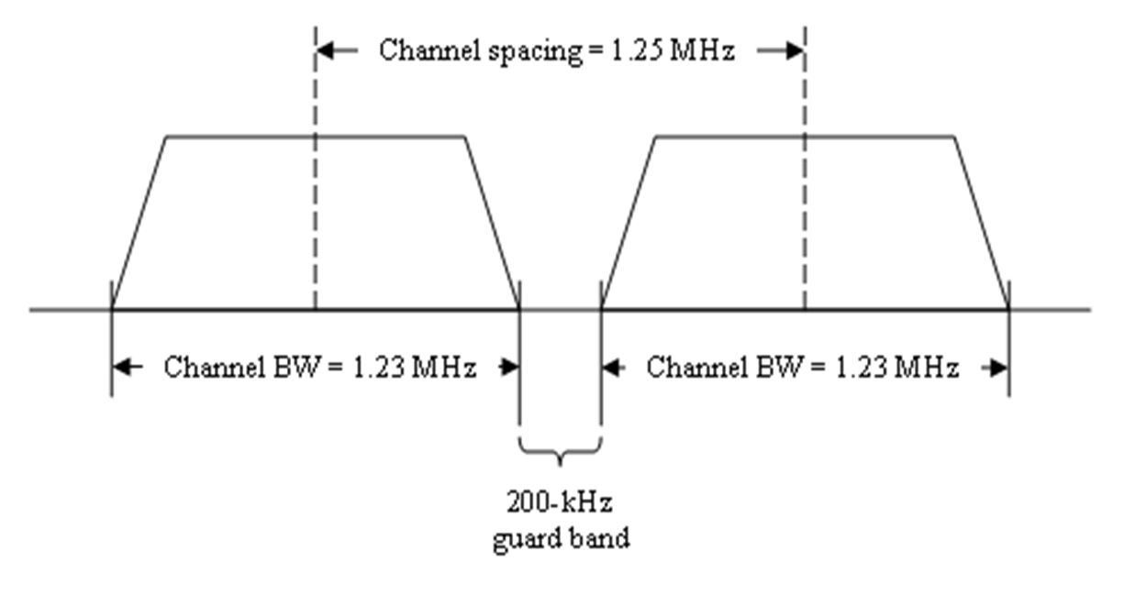
CDMA Channel Bandwidth

Slide 34
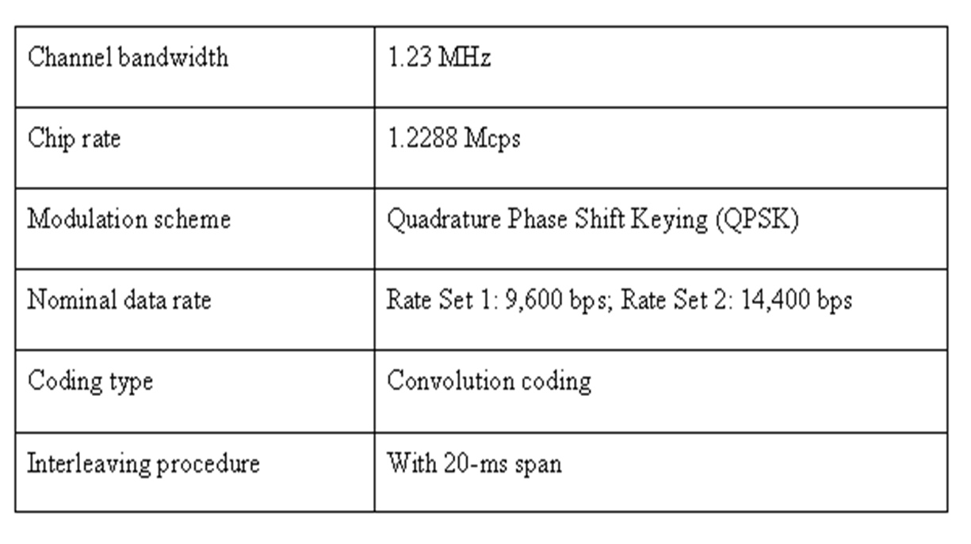
Modulation and Coding Features

Slide 35
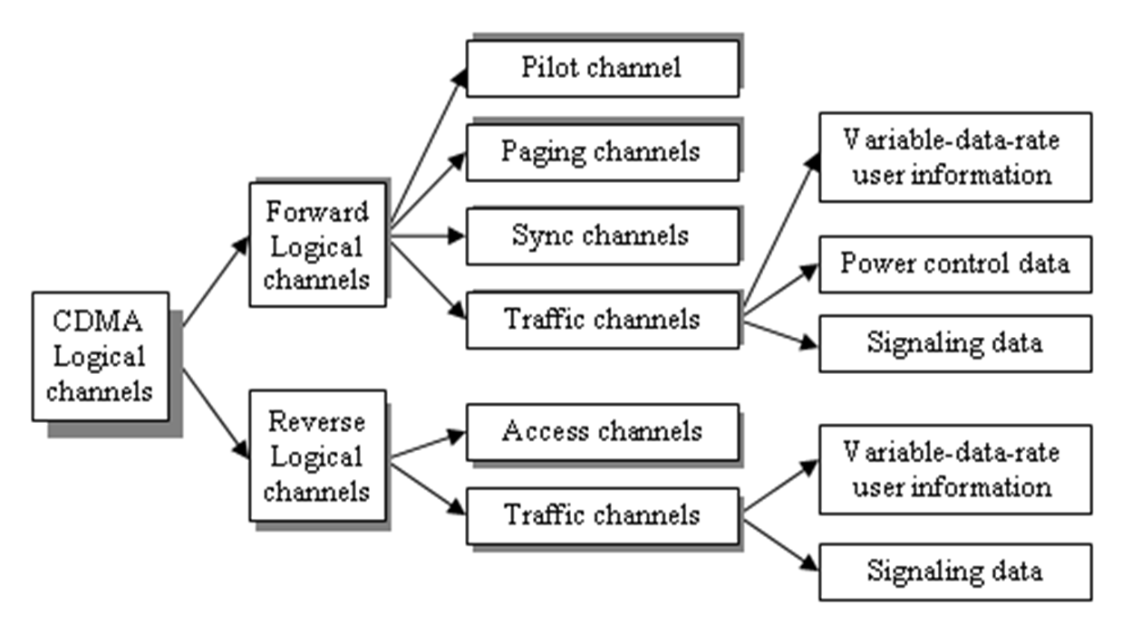
Classification of Logical Channels

Slide 36
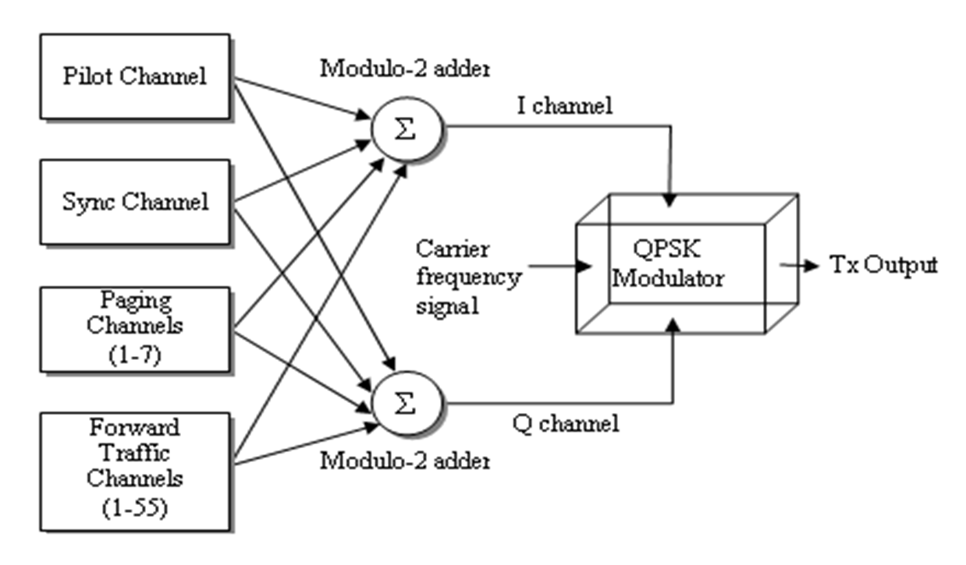
Multiplexing of CDMA channel

Slide 37
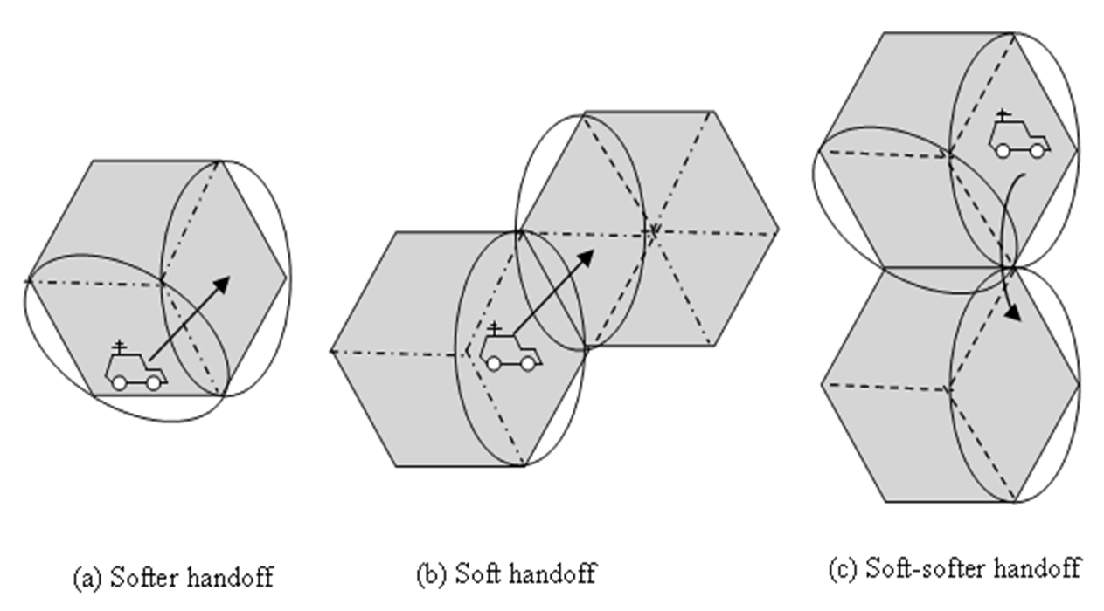
Soft Handoff in CDMA

Slide 38
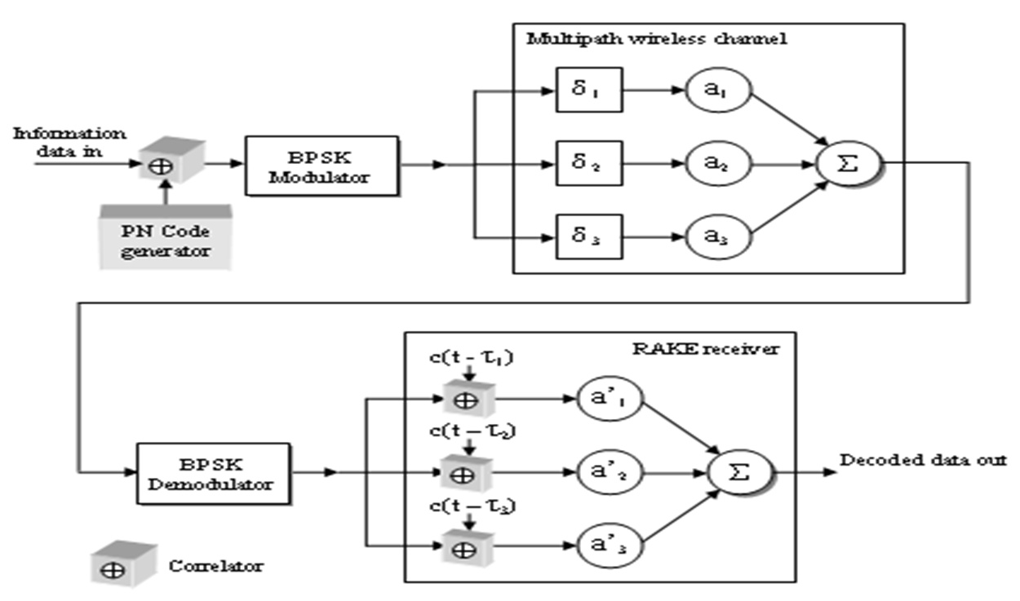
Principle of RAKE Receiver

Slide 39
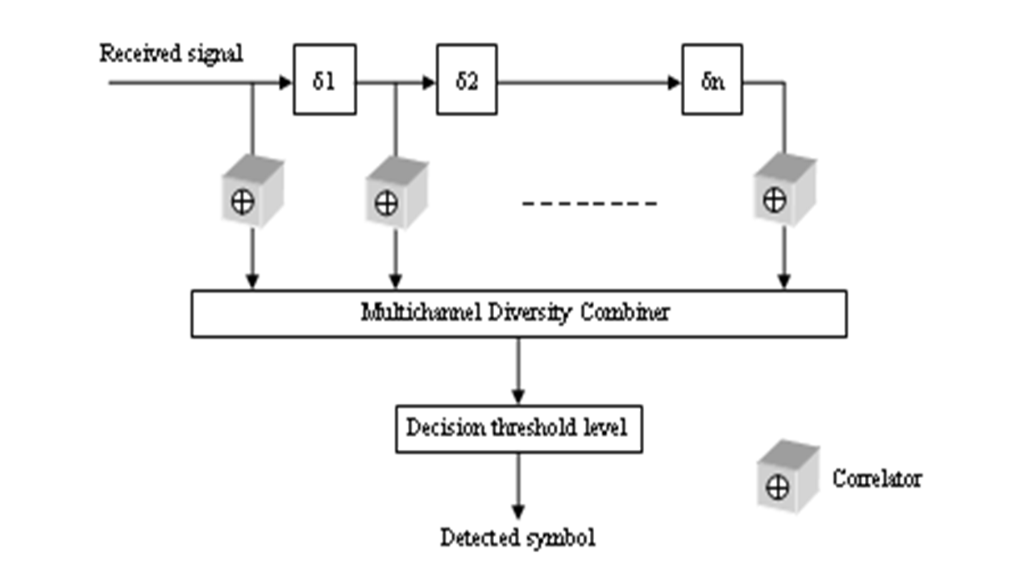
RAKE Receiver Operation

Slide 40
Summary
2.5G cellular standards include GPRS, EDGE, and cdmaOne
IMT-2000 represents a global cellular 3G standard
3G offers integrated services with seamless connectivity
4G wireless networks support global roaming across multiple wireless and mobile networks.

